Slide 1
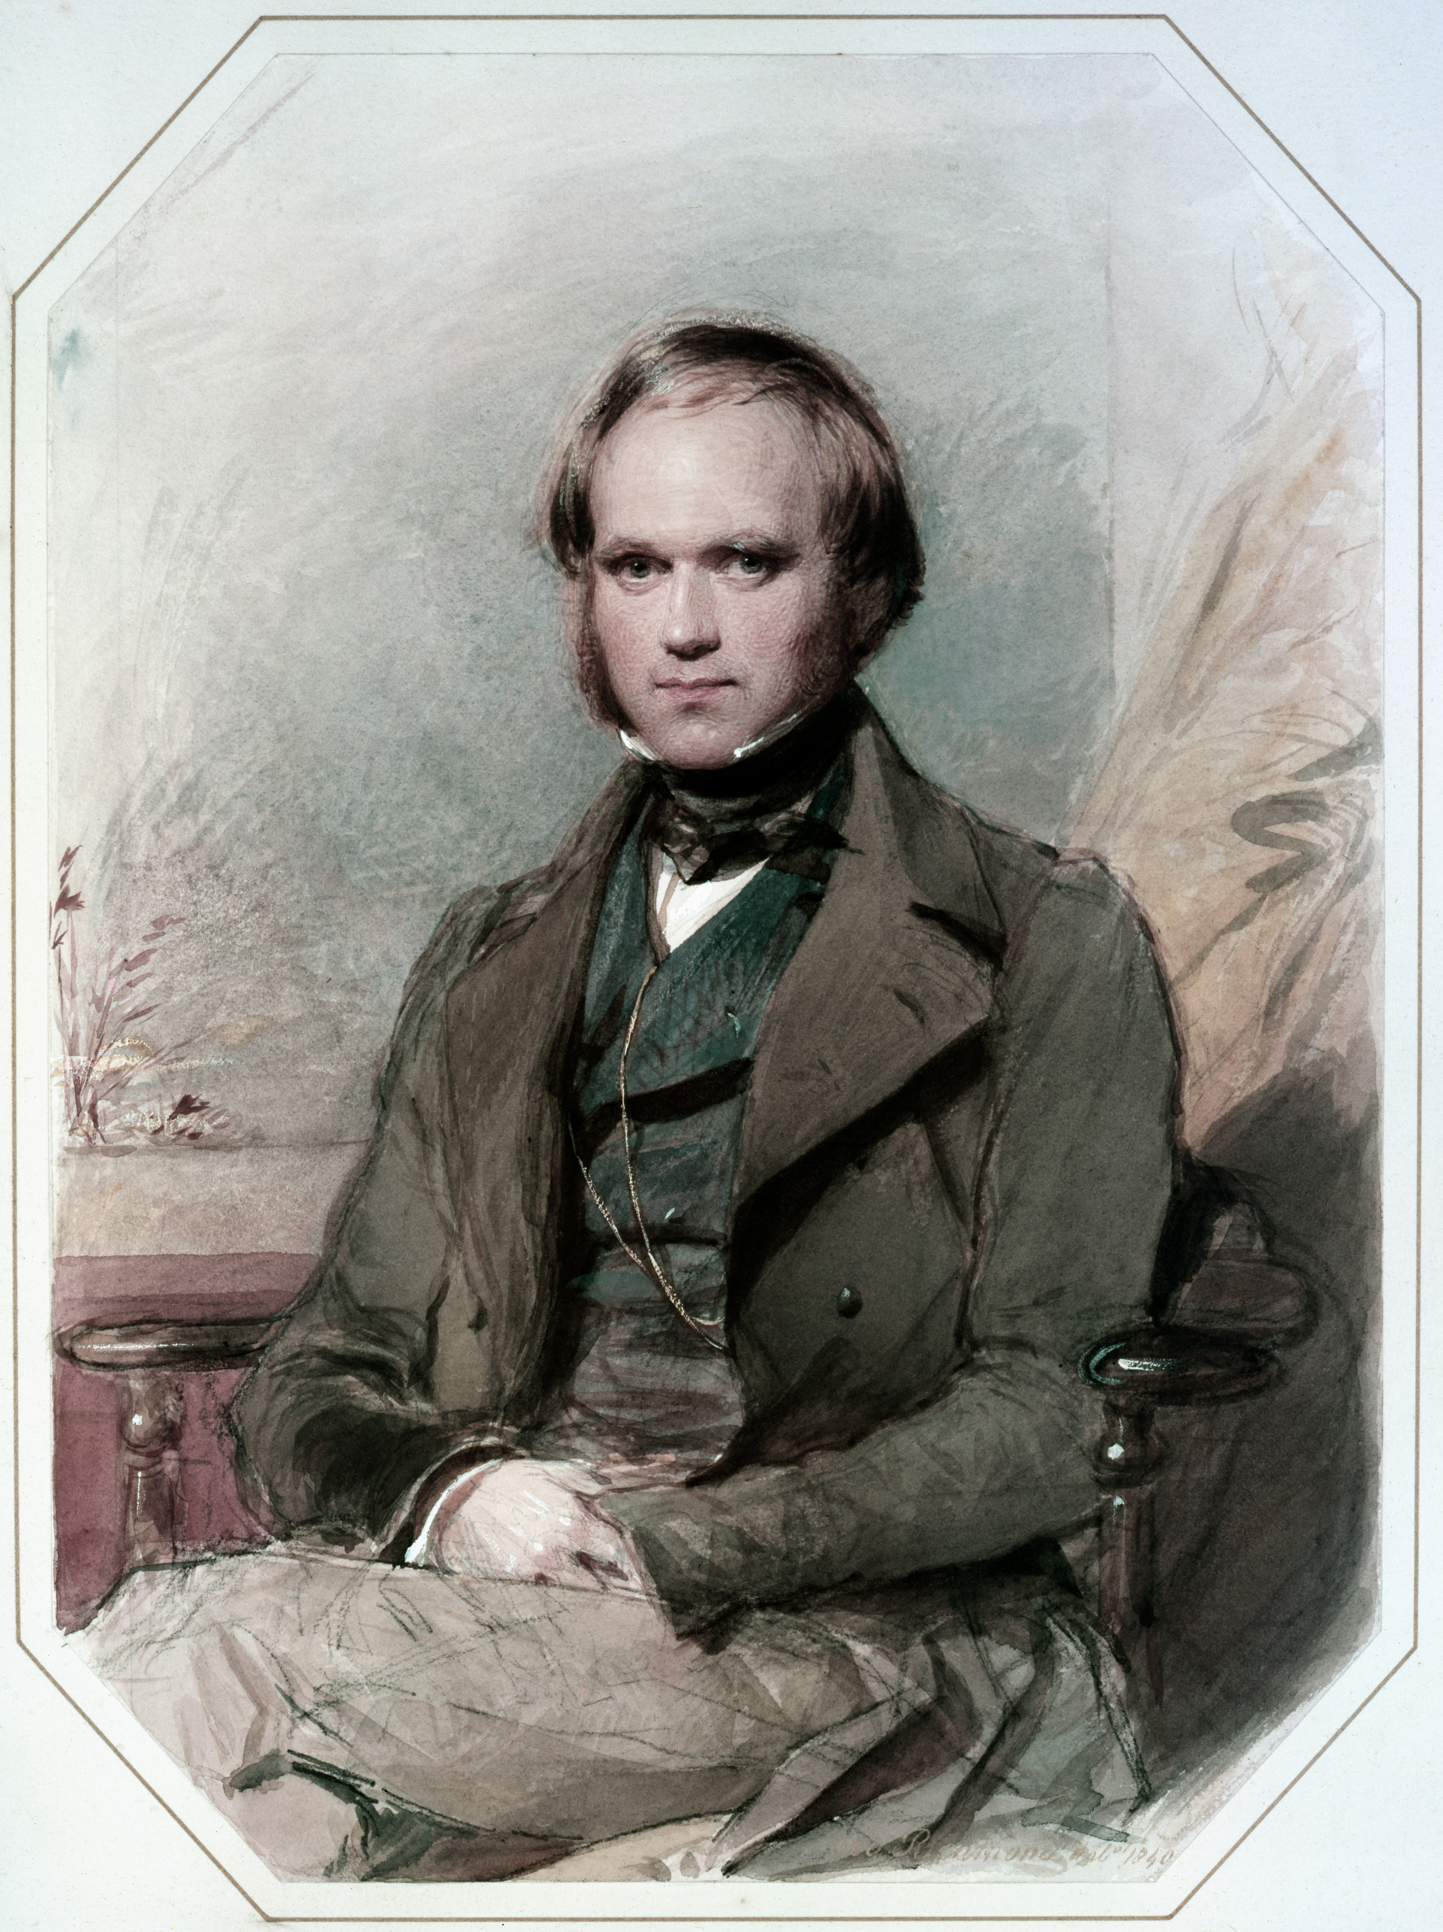
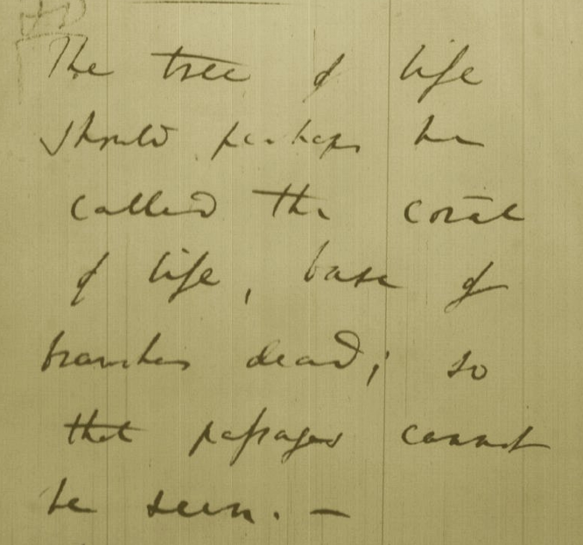
Tree, Web, or Coral of Life?
“The tree of life should perhaps be called the coral of life, base of branches dead”
Charles Darwin
painted by George Richmond in the late 1830
Page B26 from Charles Darwin’s (1809-1882) notebook (1837/38)

Slide 2
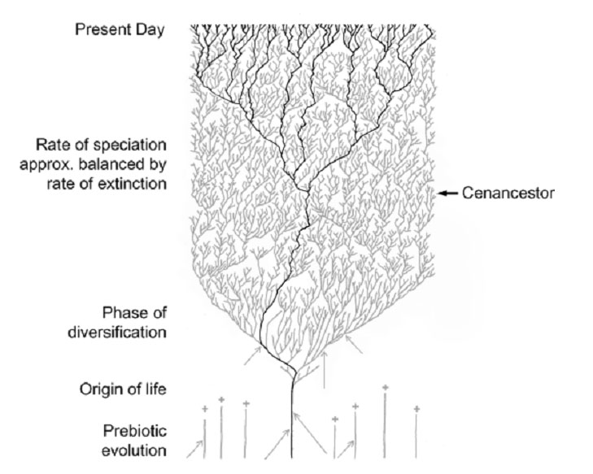
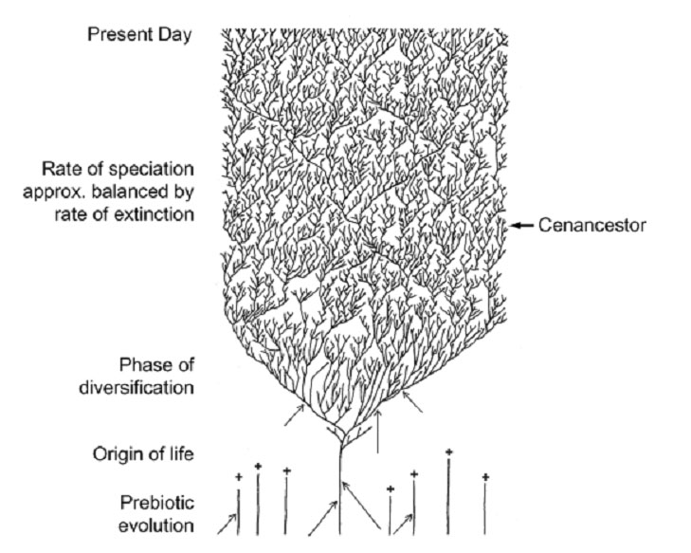
The Coral of Life (Darwin)
ZHAXYBAYEVA and GOGARTEN (2004):
Cladogenesis, Coalescence and the Evolution of the Three Domains of Life.
Trends in Genetics 20 (4): 182- 187
Notes:
The “Coral of Life” and the transfer of characters from now extinct into surviving lineages

Slide 3
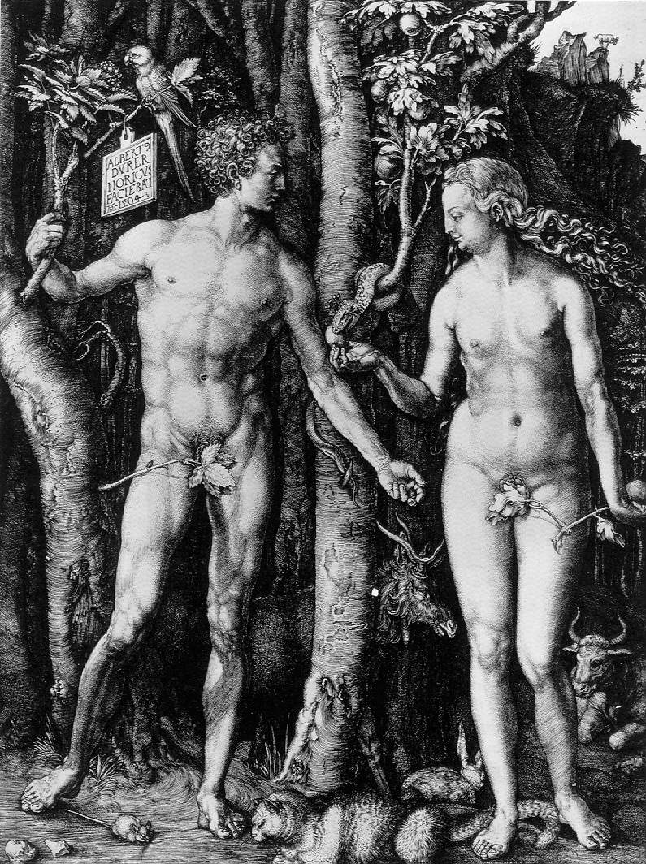
Y chromosome
Adam
Mitochondrial
Eve
Lived
approximately
40,000 years ago
Lived
166,000-249,000
years ago
Thomson, R. et al. (2000) Proc Natl Acad Sci U S A 97, 7360-5
Underhill, P.A. et al. (2000) Nat Genet 26, 358-61
Mendez et al. (2013) American Journal of Human Genetics 92 (3): 454.
Cann, R.L. et al. (1987) Nature 325, 31-6
Vigilant, L. et al. (1991) Science 253, 1503-7
Albrecht Dürer, The Fall of Man, 1504
Adam and Eve never met ☹
The same is true for ancestral rRNAs, EF, ATPases!

Slide 4
Can one reconstruct microbial phylogeny?
PHYLOGENY:
from Greek phylon, race or class, and -geneia, born.
“the origin and evolution of a set of organisms, usually of a species” (Wikipedia);
Phylogeny does not necessarily occur in a tree-like process!
Notes:
Check time 30 ?

Slide 5
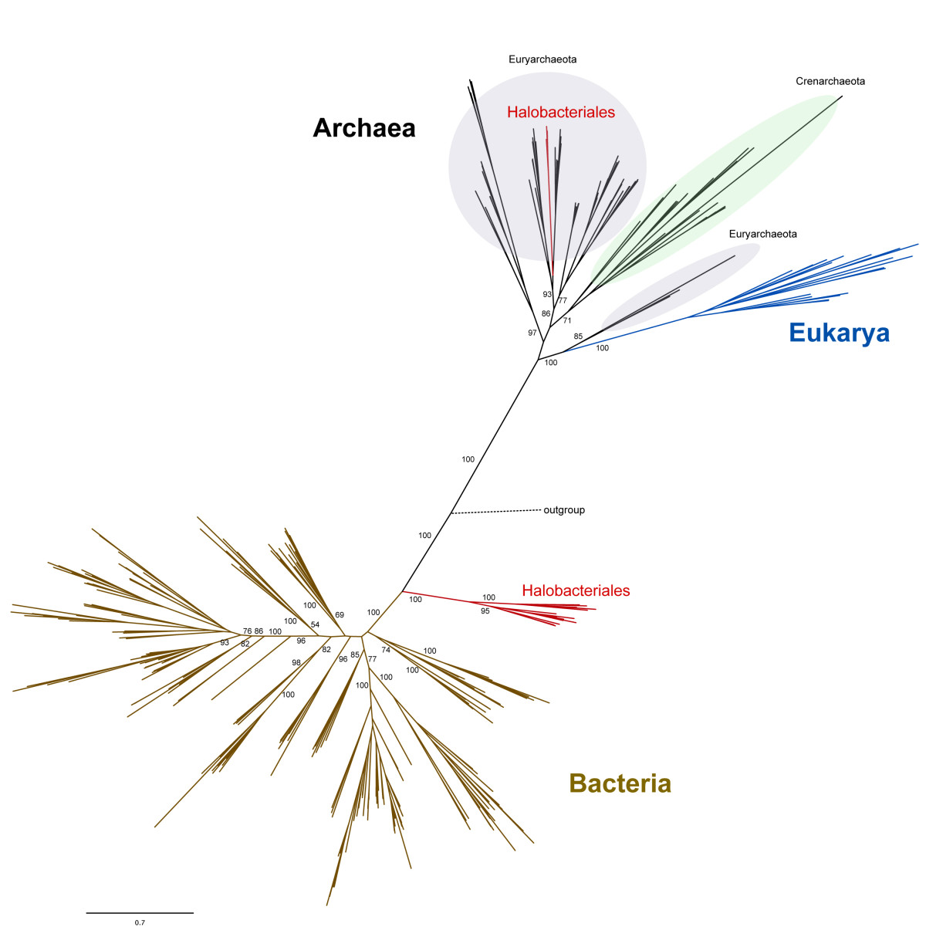
leucyl-tRNA synthetase
phylogeny
Ancient origin of the divergent forms of leucyl-tRNA synthetases in the Halobacteriales
Cheryl P Andam, Timothy J Harlow, R Thane Papke and
J Peter Gogarten
BMC Evolutionary Biology 12:85

Slide 6
Gene Transfer and Phylogenetic Reconstruction: Friends or Foes?
Popular view
Gene transfer is a disruptive force in phylogenetic reconstruction.
New view
Events of ancient gene transfer are valuable tools for reconstructing organismal phylogeny.
Notes:
Check time 15 minutes?

Slide 7
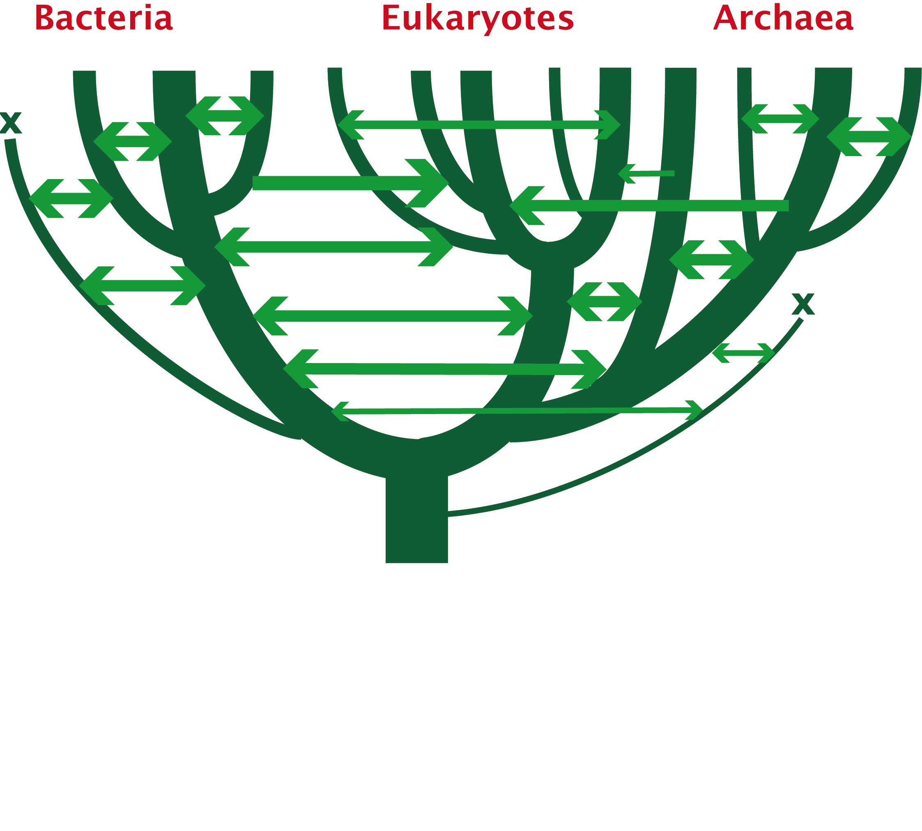
1. Any ancient gene transfer to the ancestor of a major lineage implicitly marks the recipient and descendents as a natural group.
2. The donor must exist at the same time or earlier than the recipient.
Ancient HGTs

Slide 8
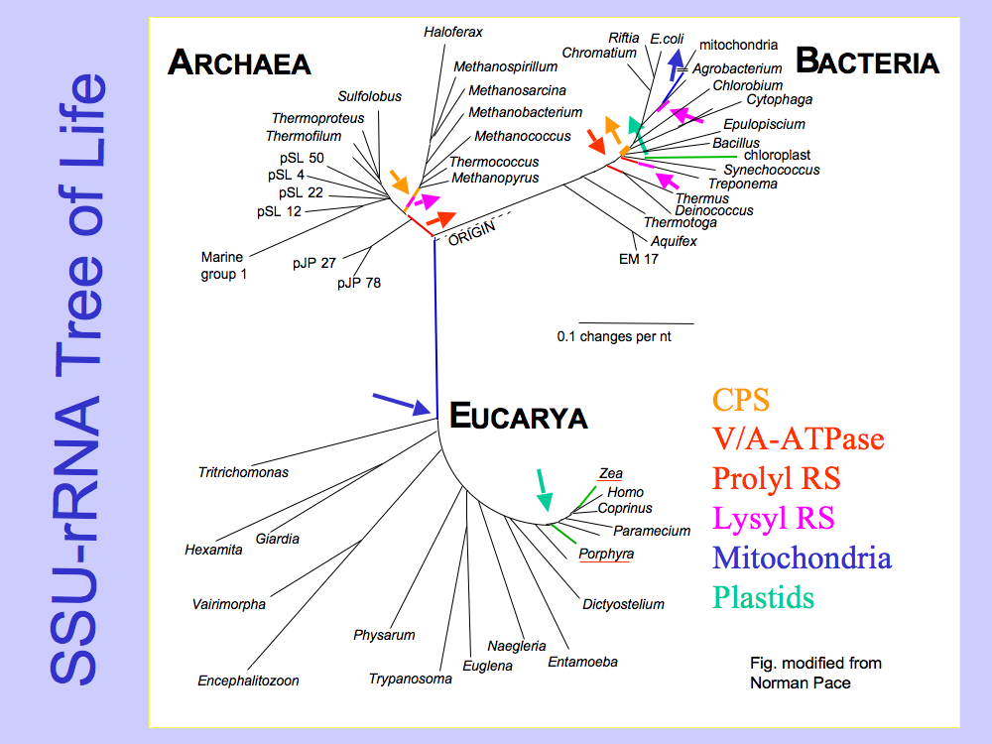
Small subunit ribosomal RNA (16S) based tree of life.
Carl Woese, George Fox, and many others.

Slide 9
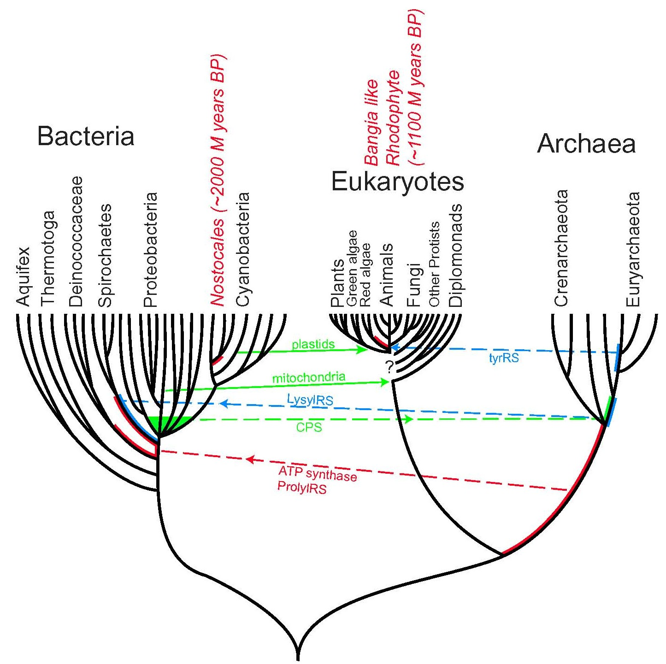
Presence of a transferred gene is a shared derived character that can be useful in systematics.
Gene “ping-pong” between different lineages can be used to build correlations between different parts
of the tree/net of life.
Notes:
Gene ping pong
Fossil record for the early evolution is sparse -- gene transfer allows to use marker from one group also for other groups
Tyrosyl tRNA synthetase

Slide 10
Gene transfer as a tool to correlate evolutionary events and define clades
Bacterial and archaeal groups had already diverged into different families and genera, before the major eukaryotic kingdoms diverged.
  Animals – Fungi diverge after split of Haloarchaea into lineages that contain Halobacterium and Haloarcula, respectively.
  Archaeplastida (glaucocystophytes, red-, and green algae) diverge after Chlamydiae split into lineages containing Chlamydia and Parachlamydia, respectively.
  All Prochlorococcus species possess a threonyl RS acquired from a marine gamma Proteobacterium.

Slide 11
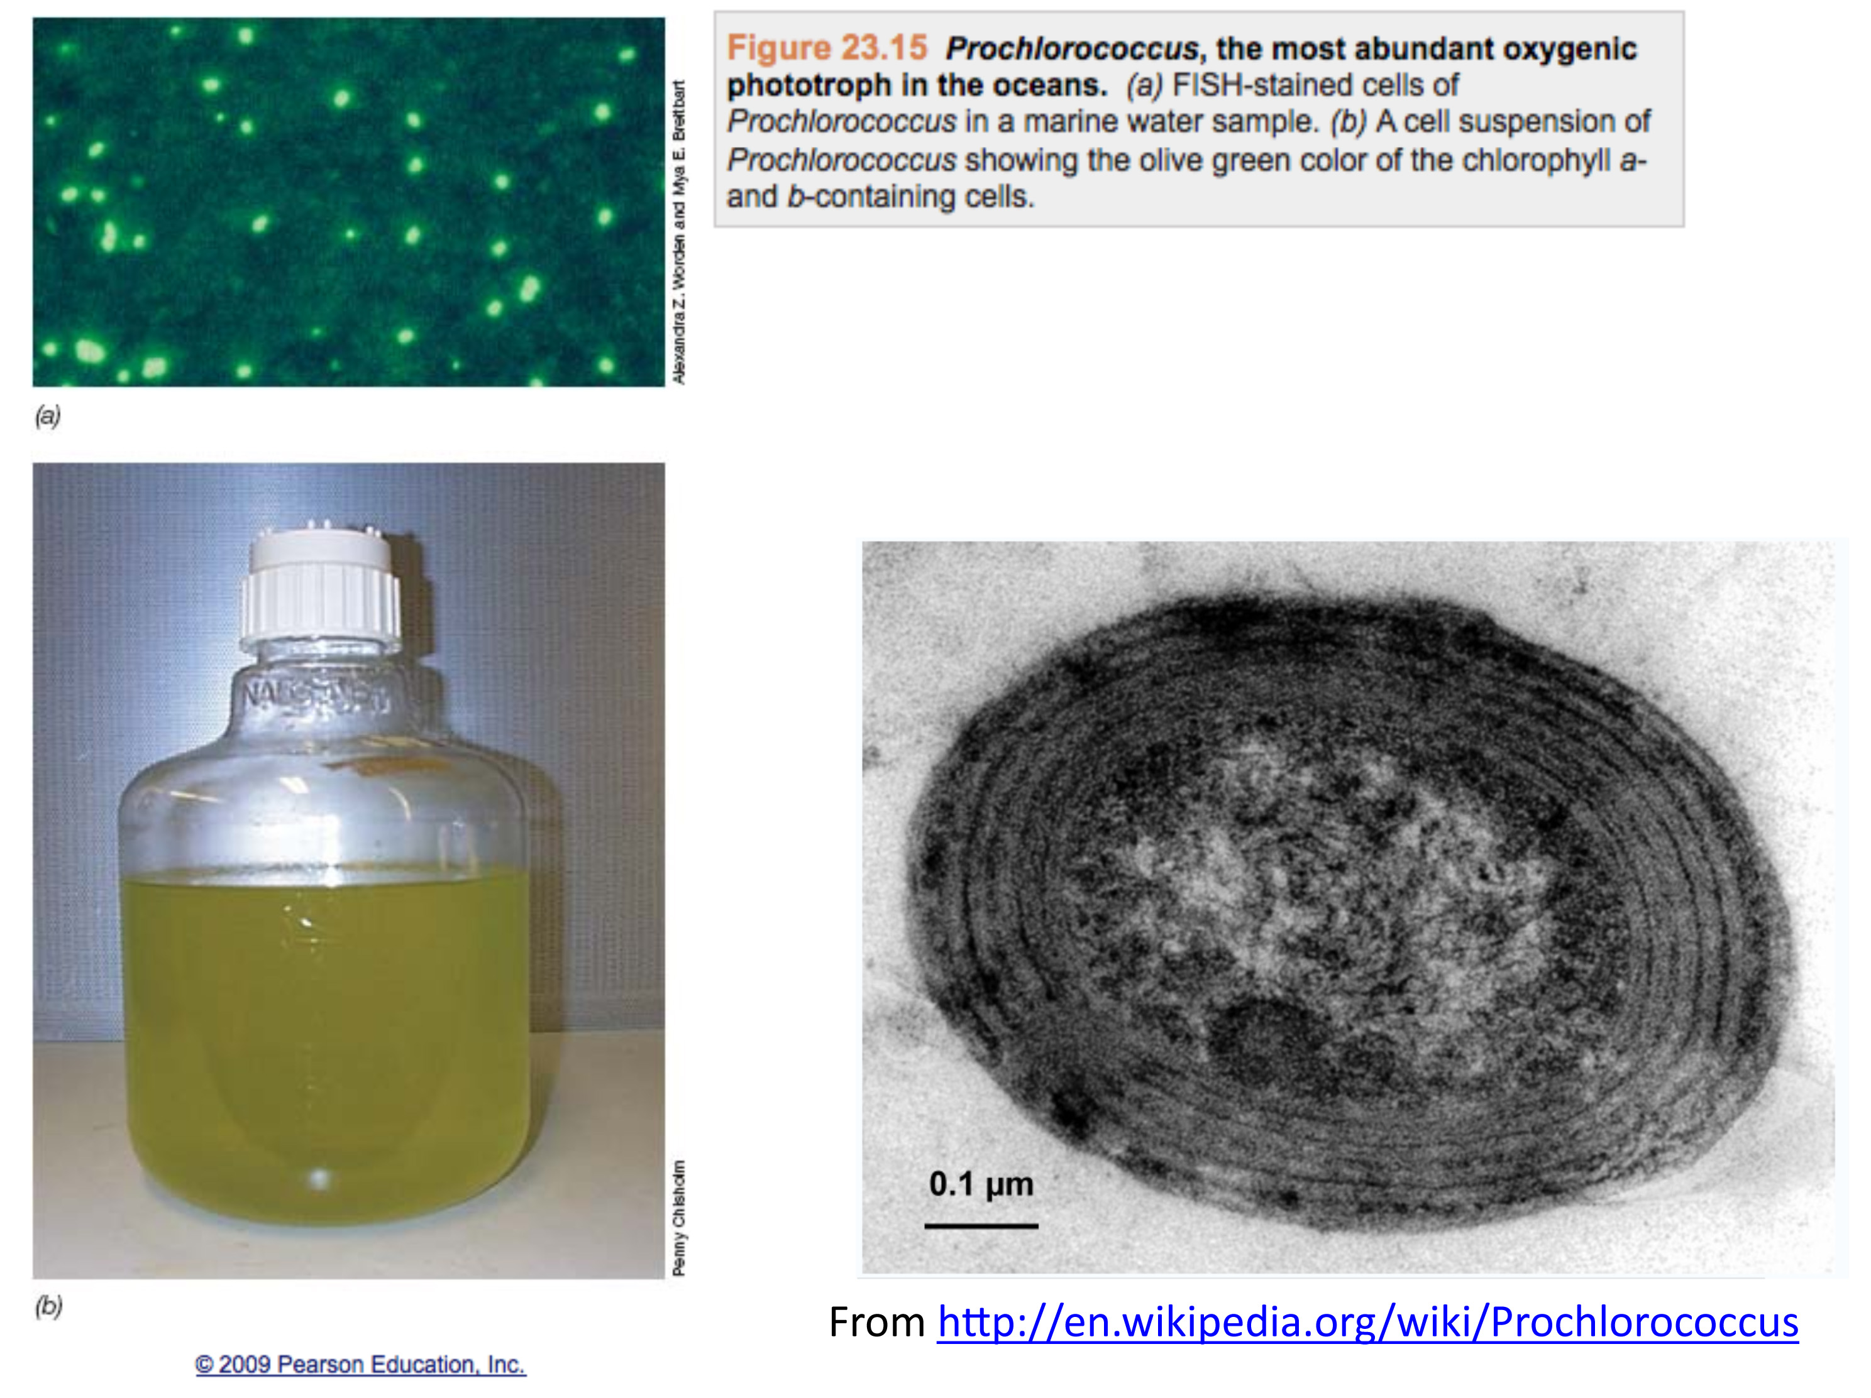

Slide 12
ThrRS Phylogeny – γ-Proteobacteria
Outgroup (β-Proteobacteria)
Enterobacteriales
Xantho- and
Pseudomonadales
HTCC5015
marine γ-proteobacterium
(Sargasso Sea)
Oceanospirillales
high light
low light
Notes:
Grouping of prochlorococcus with planctonic marine open ocean gamma suggest that the transfer took place in the open ocean environment, before the divergence of the different prochlorococci, and after the divergence from Synecchococci, the other group of small marine cyanobacteria.

Slide 13
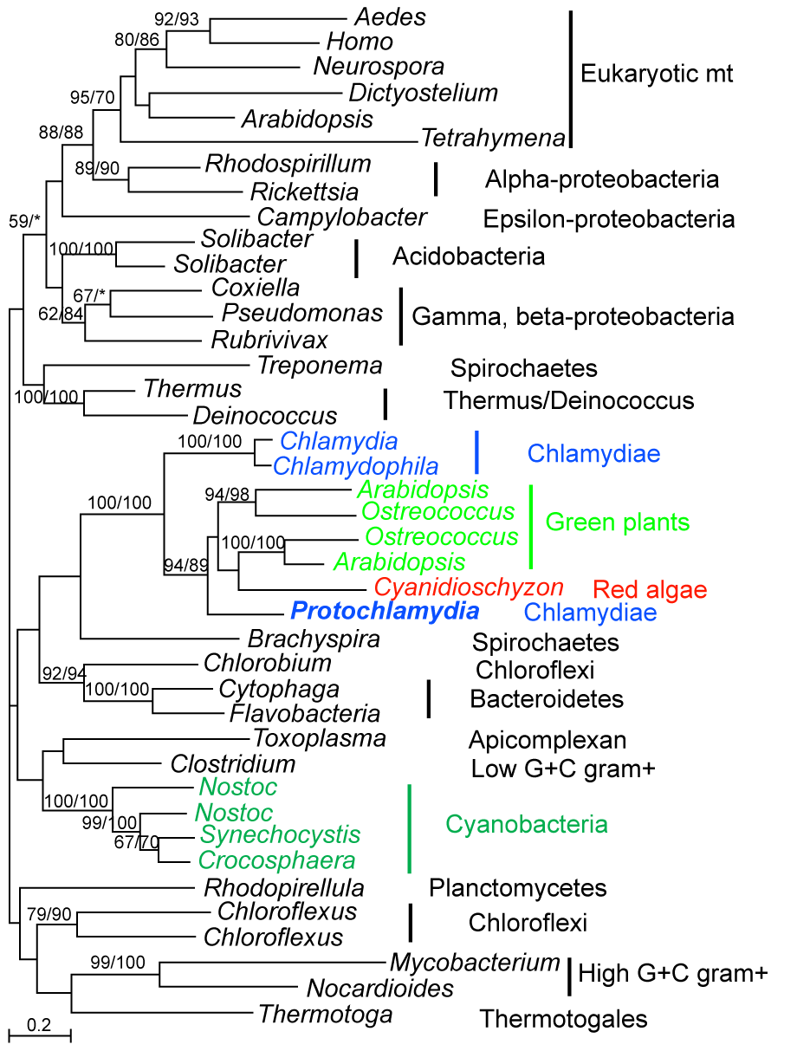
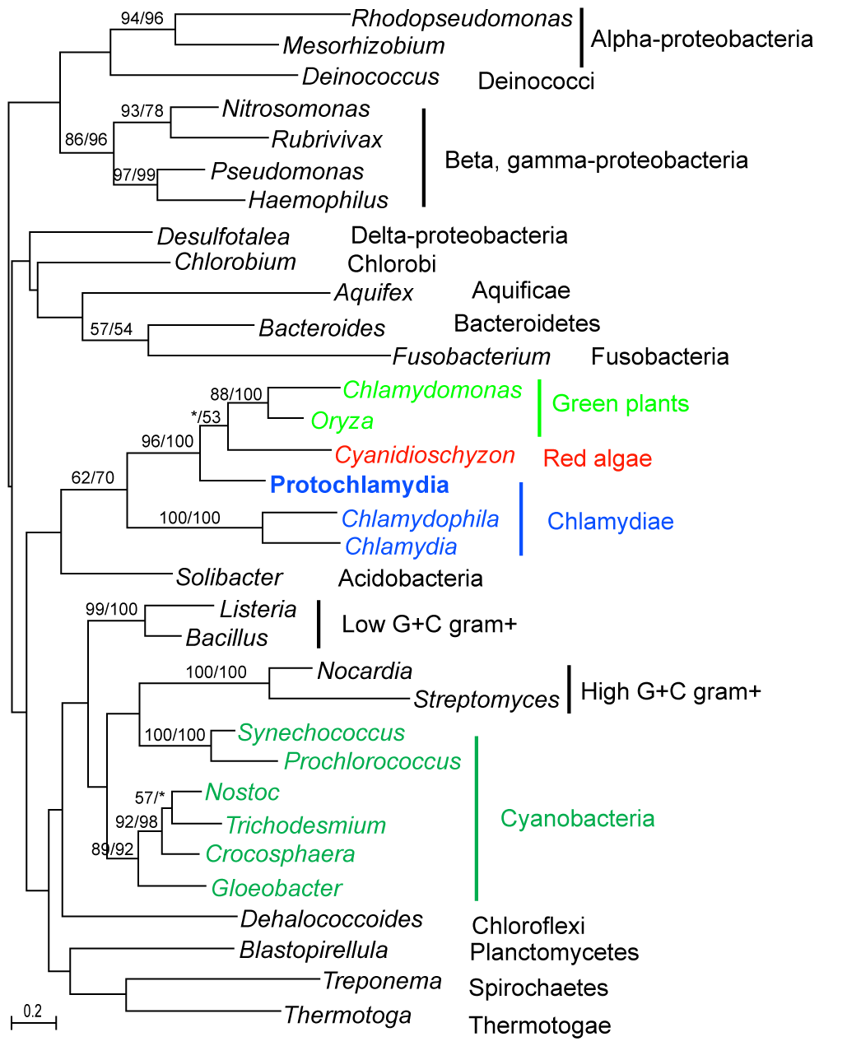
Chlamydial-type genes in red algae and plants are often specifically associated with Protochlamydia (Parachlamydia)
Huang and Gogarten 2007, Genome Biol 8:R99
Beta-ketoacyl-ACP synthase (fabF)
4-diphosphocytidyl-2-C-methyl-D-erythritol kinase (ispE)

Slide 14
Red Algal and Green Plant Genes of Chlamydial Origin
Consistent phylogenetic signal links
Chlamydiae, red algae and green plants.
modified from
Huang and Gogarten 2007, Genome Biol 8:R99
Additional genes reported in
Becker B, Hoef-Emden K, Melkonian M.
BMC Evol Biol. 2008 Jul 15;8:203.
Moustafa A, Reyes-Prieto A, Bhattacharya D..
PLoS ONE. 2008 May 21;3(5):e2205.
Notes:
mention signalP

